Slide 1
Networking Devices

Slide 2
Networking Devices
Repeaters
Hubs
Collisions
Bridges
Routers
Gateways

Slide 3
What are internetworking devices?
Internetworking devices are products used to connect networks. As computer networks grow in size and complexity, so do the internetworking devices used to connect them.

Slide 4
The purposes of having devices
First, they allow a greater number of nodes to be connected to the network.
Second, they extend the distance over which a network can extend.
Third, they localize traffic on the network.
Fourth, they can merge existing networks.
Fifth, they isolate network problems so that they can be diagnosed more easily.

Slide 5
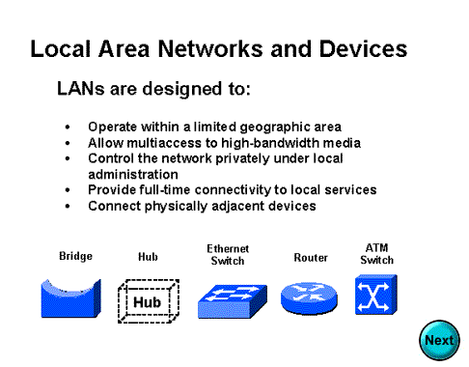

Slide 6
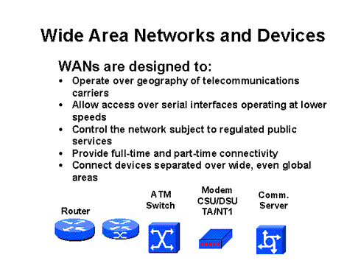

Slide 7
What internetworking devices operate at the physical layer (layer 1) of the OSI model?
A repeater can provide a simple solution if either of these two problems exists.
When signals first leave a transmitting station, they are clean and easily recognizable. However, the longer the cable length, the weaker and more deteriorated the signals become as they pass along the networking media.

Slide 8
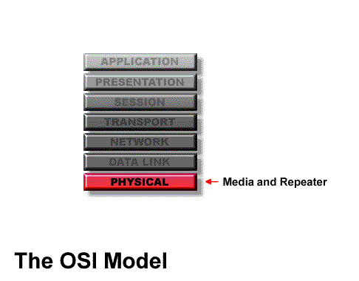
Location of Repeater

Slide 9
Hub
Multi-port repeaters are often called hubs. Hubs are very common internetworking devices. Generally speaking, the term hub is used instead of repeater when referring to the device that serves as the center of a star topology network.

Slide 10
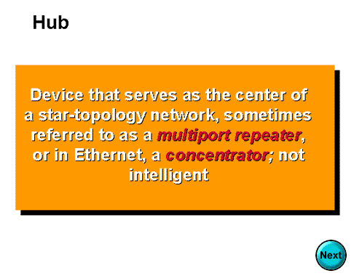

Slide 11
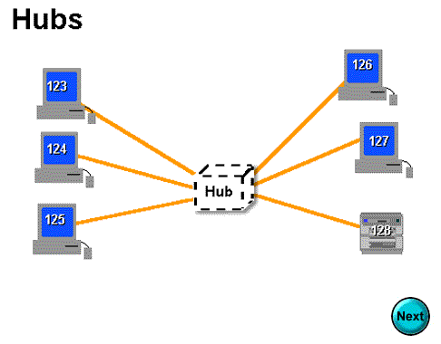

Slide 12
What is the disadvantage associated with using a repeater?
it can't filter network traffic. Data, sometimes referred to as bits, arriving at one port of a repeater gets sent out on all other ports
data gets passed along by a repeater to all other LAN segments of a network regardless of whether it needs to go there or no

Slide 13
What problem could occur as a result of too much traffic on a network?
if segments of a network are only connected by non-filtering devices such as repeaters, this can result in more than one user trying to send data on the network at the same time
If more than one node attempts to transmit at the same time, a collision will occur.
When a collision occurs, the data from each device impact and are damaged

Slide 14
What internetworking device can be used to filter traffic on the network?
One way to solve the problems of too much traffic on a network and too many collisions is to use an internetworking device called a bridge.
A bridge eliminates unnecessary traffic and minimizes the chances of collisions occurring on a network by dividing it into segments

Slide 15
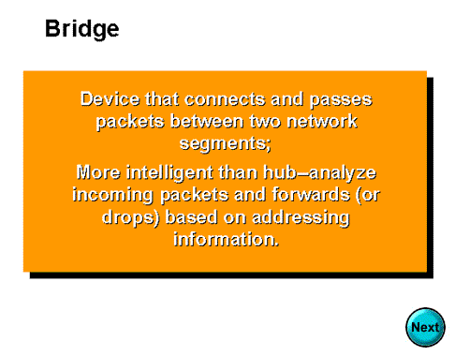

Slide 16
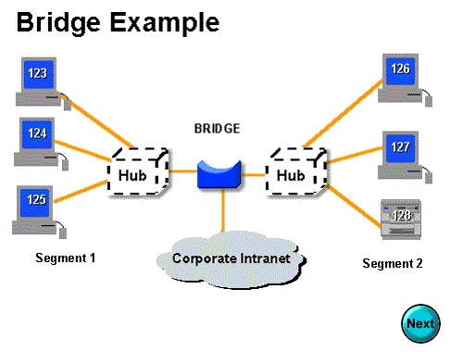

Slide 17
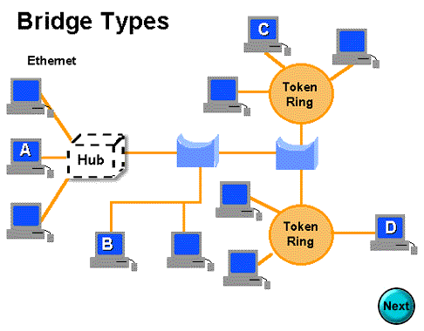

Slide 18
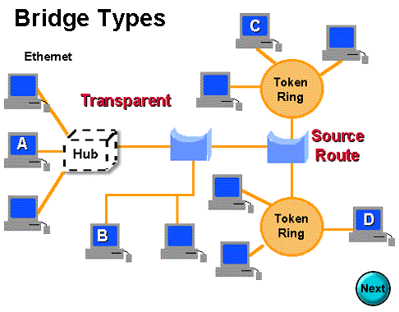

Slide 19
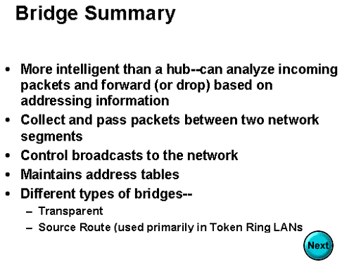

Slide 20
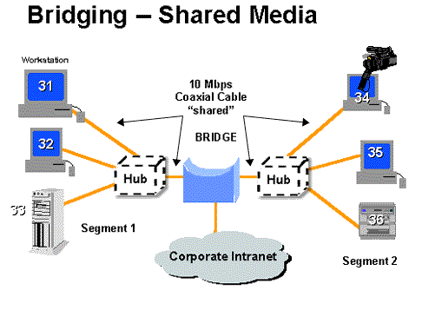

Slide 21
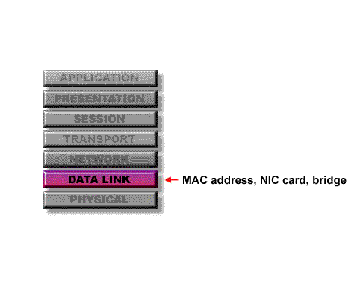
At what layer of the OSI model do bridges operate?
Because bridges operate at the data link layer, layer 2, they are not required to examine upper-layer information.

Slide 22
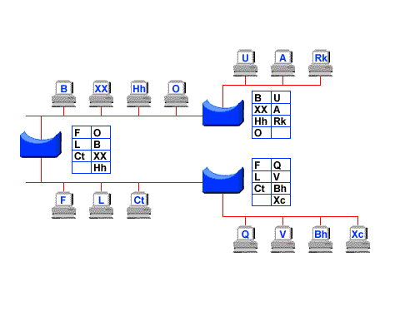
How do bridges filter network traffic?

Slide 23
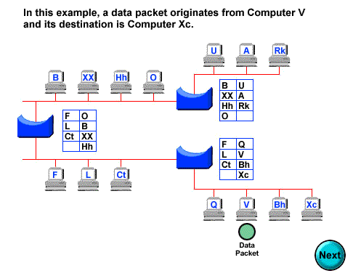

Slide 24
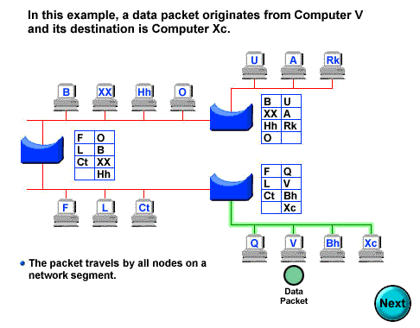

Slide 25
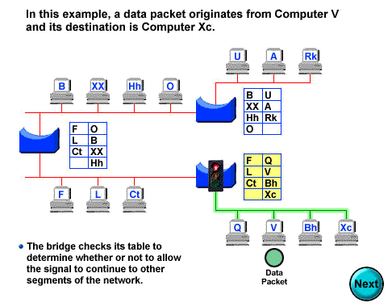

Slide 26
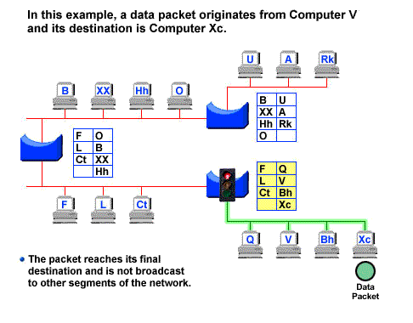

Slide 27


Slide 28
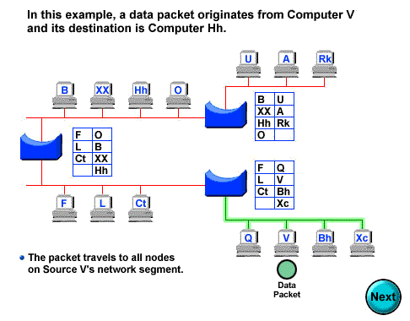

Slide 29
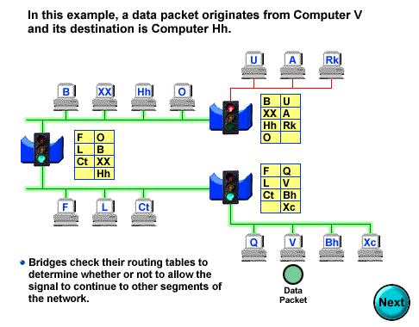

Slide 30
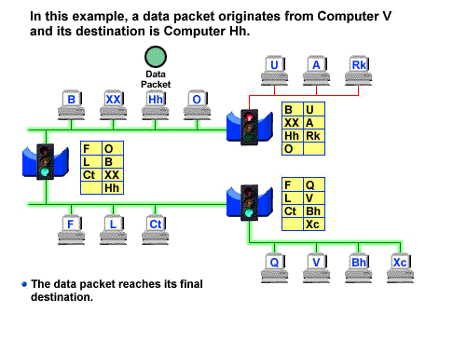

Slide 31
How are bridge data-forwarding decisions limited?
Although bridges use tables to determine whether or not to forward data to other segments of the network, the types of comparisons and decisions they make are relatively low level, simple ones

Slide 32
What types of network traffic problems is a bridge incapable of solving?
Bridges work best where traffic from one segment of a network to other segments is not too great.
However, when traffic between network segments becomes too heavy, the bridge can become a bottleneck and actually slow down communication.

Slide 33
How many addressing schemes are there in networking?
You have already learned what one of these addressing schemes is. It is the MAC address.
The second addressing scheme in networking makes use of what is called the IP address.

Slide 34
How do IP addresses differ from MAC addresses?
Like MAC addresses, every IP address is unique. No two IP addresses are ever alike.
However, while MAC addresses are physical addresses that are actually hard-coded into the NIC card and occur at the data link layer
IP addresses are implemented in software and occur at the network layer of the OSI model.

Slide 35
What are routers?
Routers are another type of internetworking device.
These devices pass data packets between networks based on network protocol or layer 3 information.
Routers have the ability to make intelligent decisions as to the best path for delivery of data on the network.

Slide 36
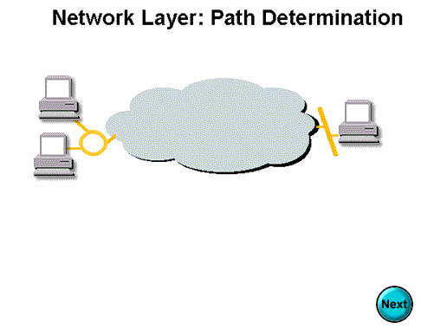

Slide 37
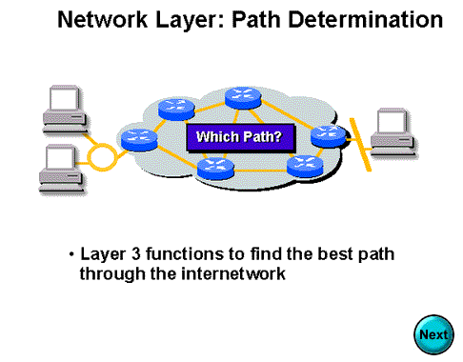

Slide 38
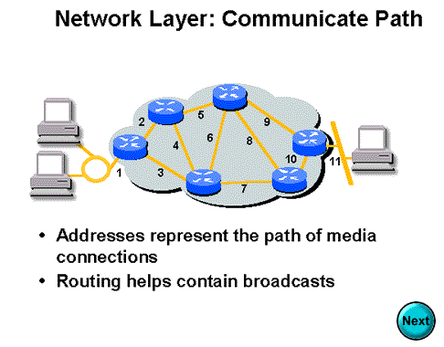

Slide 39
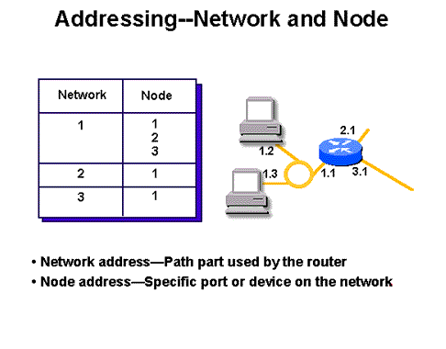

Slide 40
What network problems can routers help resolve?
The problem of excessive broadcast traffic can be solved by using a router.
Routers are able to do this, because they do not forward broadcast frames unless specifically told to do so

Slide 41
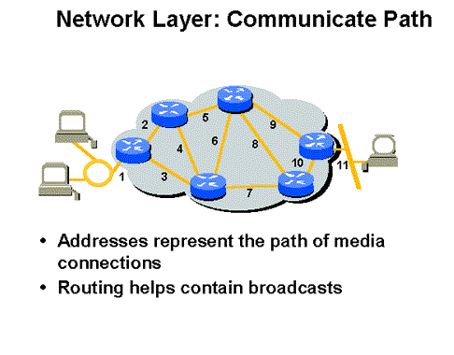

Slide 42
How do routers differ from bridges?
Routers differ from bridges in several respects. First, bridging occurs at the data link layer or layer 2,while routing occurs at the network layer or layer 3 of the OSI model.
Second, bridges use physical or MAC addresses to make data forwarding decisions. Routers use a different addressing scheme that occurs at layer three

Slide 43
How do routers work?
Routers are used to connect two or more networks. For routing to be successful, each network must have a unique network number

Slide 44
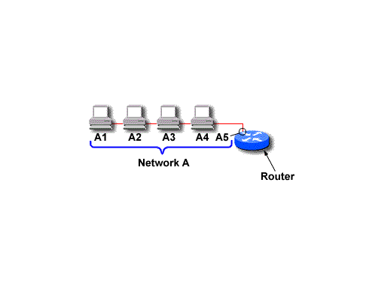
The port where a router connects to network A would have an IP address of A5.

Slide 45
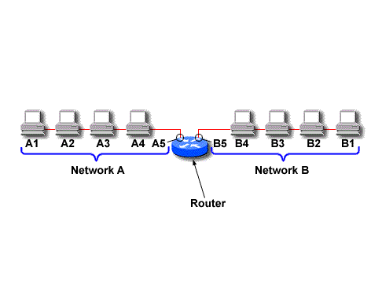
The IP address of the router's second interface would be B5.

Slide 46
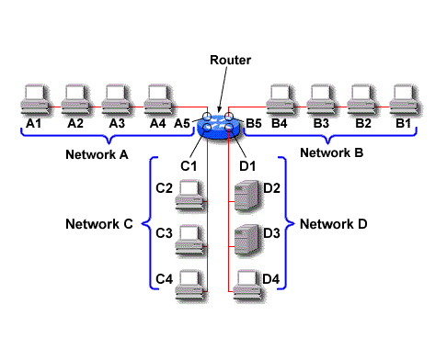
The router would determine to send the data from network A to network B out its port with the IP address B5.

Slide 47
How do routers differ from Gateways?
Router does the same things as Gateways except that Gateways connect dissimilar network while Routers connect the similar networks.
Gateways work on transport layer while Routers work on Network layer.
Gateways deals with Port address while Routers deal with IP addresses.

